Slide 1

Capstone Project – I 7CS1999
Alliance School of Advanced Computing
Project Title: An AI-Powered Crop Disease Detection and Agrochemical Recommendation Framework
Batch : 2023 - 2027
Review No : 2
Batch No : ASAC-CP-009
Presented by
Student Name Branch Reg No
Chalini M CSE-AIML 2023BCSE07AED440
Spandana Basava Kulal CSE-AIML 2023BCSE07AED441
Name of the Mentor: Dr. Qawsar Gulzar

Slide 2

Outline
Project Overview
Objectives
Literature Review
Research Gap
Scope
Requirements Analysis
Proposed Methodology
System Architecture
Project work plan and timeline
References

Slide 3
I. Project Overview
Problem Context – Farmers may struggle to identify crop diseases early and select the appropriate agrochemical treatment. Traditional diagnosis can be time-consuming and dependent on expert knowledge.
Motivation – To develop an AI-based system that can detect crop diseases from plant images and provide suitable agrochemical recommendations.
Significance – Helps in early disease detection, reduces unnecessary agrochemical usage, supports better farming decisions, and protects agricultural data through secure communication.
Application Domain – Smart Agriculture / Precision Agriculture / AI in Agriculture / Cloud Security
Target Users – Farmers, agricultural consultants, agronomists, agricultural researchers, and farm-management organizations.

Slide 4
II. Objectives
Crop Disease Detection: Develop an AI-based system to identify and classify crop diseases from leaf images.
Image Preprocessing: Improve image quality and prepare the dataset for effective disease classification.
Smart Agrochemical Recommendation: Recommend suitable agrochemical treatments based on the detected crop disease using reliable agricultural information.
System Integration and Validation: Integrate disease detection and treatment recommendation modules and evaluate the system’s performance.

Slide 5
III. Literature Review
Author Name, Journal/Conference, Year | Research / Methodology | Dataset Used | Performance Metrics | Advantages | Disadvantages
1. S. K. Mahmudul Hassan and Arnab Kumar Maji, IEEE Access, 2022. | Novel CNN combining Inception layers, residual connections and depthwise-separable convolutions to reduce model parameters. | PlantVillage (corn, potato and tomato disease classes); rice disease dataset (5,932 images); cassava disease dataset (5,656 images). | Reported validation accuracy: 99.39% on PlantVillage, 99.66% on rice and 76.59% on cassava. The paper also evaluates precision, recall and F1-score. | Lightweight architecture with fewer parameters; tested across multiple crops; evaluated on both controlled and field-condition images. | Substantial performance drop on cassava; class imbalance and complex backgrounds affect generalization.
2. C. J. Xan et al., IEEE Access, 2024. | Compares MobileNet V1/V2, FD-MobileNet, ResNet and SqueezeNet, optimized and quantized for ARM-M microcontroller deployment. | 5,932 rice-leaf images covering bacterial blight, blast, brown spot and tungro. | 98.44% accuracy for FD-MobileNet. | Lightweight inference; designed for resource-constrained hardware and real-time, on-device disease detection. | Limited to rice diseases; hardware and memory constraints restrict the model choices and deployment scope.
3. R. Maurya, L. Rajput and S. Mahapatra, IEEE Access, 2025 | RAI-Net: fine-tuned ResNet18 with channel attention and Inception modules; Grad-CAM provides visual explanations of predictions. | 22,930 tomato-leaf images, 10 classes; test set of 4,595 images. | 97.88% accuracy on the 4,595-image test set. | Multi-scale feature extraction; visual explanations help identify image regions influencing predictions; specialized for tomato diseases. | Limited to tomato in the reported experiment; broader validation under uncontrolled field conditions is still needed.

Slide 6
4. W. Xiao et al., IEEE Access, 2025. | framework using class-agnostic contrastive supervised and sparse orthogonal mapping to reduce background interference and improve feature separation. | Newly introduced citrus-leaf dataset: 5,763 images across 6 categories, including field variations in illumination, occlusion and lesion scale. | 97.1% accuracy, reported as a 2.4-percentage-point improvement over ResNet-18. | Specifically addresses complex field images; supports lesion localization and better separation of disease features. | Focused on citrus; additional large-scale testing across crops, regions and growing conditions is needed.
5. T.-C. Pham et al., IEEE Access, 2025. | Iterative active learning with diverse expansion sampling to select informative, representative samples for annotation. | VIECOLD and BRACOL coffee-leaf disease datasets from different countries | F1-score improvement of 1.7% on VIECOLD and 0.9% on BRACOL using the same labeled-data BRACOL labels surpassed the corresponding full-data baseline. | Reduces manual labeling requirements; improves data efficiency and can lower annotation costs. | Requires repeated sample selection and human annotation; effectiveness depends on sample diversity and the baseline model.
6. Arfat Ahmad Khan, Muhammad Faheem, Rab Nawaz Bashir, Chitapong Wechtaisong and Muhammad Zahid Abbas, IEEE Access, 2022. | IoT-assisted, context-aware fertilizer recommendation. Compares Logistic Regression, SVM, Gaussian Naïve Bayes (GNB) and KNN using soil fertility, crop and soil-type information. | Soil fertility mapping and agricultural data associated with The Islamia University of Bahawalpur, including N, P and K observations, crop and soil type. | GNB achieved 96% training accuracy and 94% testing accuracy. Mean differences for N, P and K observations were 0.34, 0.36 and −0.13, respectively. | Incorporates soil context into fertilizer recommendations; compares several ML classifiers; supports more context-aware fertilizer management. | Depends on reliable soil measurements and regional data; recommendations may need recalibration for other locations and crops.

Slide 7
7. Ayesha Khaliq, Atif Khan, Salman Jan, Muhammad Umair, Asad Gulshair, Ahmad Ali and Usman Ali Shah, IEEE Access, 2025. | AI + IoT + explainable AI. Uses TabNet for fertilizer recommendation and soil-health analysis, SwiFT for crop recommendation, and a TTL model for irrigation advice. | Integrated agricultural data comprising temperature, humidity, soil moisture, soil type, crop type, N/P/K and fertilizer information. | TabNet fertilizer recommendation: 99.3% accuracy; SwiFT crop recommendation: 98.75% accuracy; TabNet soil analysis: R² = 98.7%; TTL irrigation: 99.13% accuracy | Integrates fertilizer, crop, irrigation and soil analysis; incorporates explainability; provides a broad decision-support framework. | Results depend on the training data and fertilizer labels; the reported metrics do not by themselves establish field performance across different regions.
8. Purnima Awasthi et al., IEEE Access, 2025. | Extended Multiscale Residual Convoluted Recurrent GAN for corn-yield forecasting, combined with a Hierarchical Fuzzy Model for N/P/K fertilizer recommendations. | ICRISAT agricultural data, NASA POWER weather data and Fertilizer Association of India data; the literature review reports 3,960 records. | The literature review reports approximately 12% improvement in prediction accuracy and 15% improvement in efficiency over traditional approaches. | Combines yield prediction with fertilizer optimization; integrates weather, crop and nutrient information; uses fuzzy rules for fertilizer decisions | Focuses on corn and Indian agricultural conditions; the reported improvements should be interpreted within the study's experimental setting.
9. Weixi Ge, Jun Zhou, Pengyuan Zheng, Agriculture, 2024. | case-based reasoning (CBR), Retrieves a preliminary fertilization scheme from the knowledge graph and refines it using similar historical cases. | Rice-fertilization knowledge and historical fertilization cases. The published abstract does not specify a named public benchmark dataset. | Fertilization-scheme error rate: approximately 19.5%. Prediction accuracy for fertilizer rates: N 95.69%, P₂O₅ 79.04%, K₂O 81.67%. | Directly recommends fertilization plans agricultural knowledge; interpretable and designed to work with limited real-time field data. | Focused on rice fertilization; performance differs among nutrients, with lower accuracy for P₂O₅ and K₂O than for N.

Slide 8
IV. Research Gap
Identified Research Gap – Existing studies mainly focus on disease detection, while disease detection, agrochemical recommendation, and secure cloud communication are rarely integrated into one system.
Technical Limitations – Many existing models are trained on controlled datasets and may have reduced performance on real-field images. Recommendation systems may also depend on limited soil/crop information.
Need for Proposed Work – A system is needed that can provide early disease detection, suitable agrochemical recommendations, and secure transmission of agricultural data.
Proposed Differentiation – Our system combines AI-based disease detection + smart agrochemical recommendation in a single platform.

Slide 9
V. Research Gap Matrix
Research Area | Existing Research | Identified Research Gap | Proposed Solution
Crop Disease Detection | CNN and deep learning models classify crop diseases from leaf images. | Performance may decrease with complex backgrounds and real-field images. | Develop a multi-class disease classification system covering multiple crops.
Disease Classification | Existing models focus on specific crops or disease categories. | Limited generalization across different crops and disease classes. | Train and evaluate the model using a multi-crop dataset.
Agrochemical Recommendation | ML models recommend fertilizers using soil nutrients and crop information. | Disease-specific agrochemical recommendations are often not integrated with disease detection. | Recommend suitable treatments based on the detected crop disease.
System Integration | Disease detection and agricultural recommendation are often developed as separate modules. | Lack of a unified system connecting disease identification with treatment recommendations. | Integrate both modules into a single AI-powered application.
Practical Applicability | Many systems are evaluated using controlled datasets. | Limited consideration of field conditions, disease severity, and recommendation reliability. | Design an extensible system with scope for field-image validation and agricultural-context integration.

Slide 10
VI. Scope
Crop Disease Detection: Identify crop diseases from leaf images using deep learning techniques
Multi-Class Classification: Classify healthy and diseased leaves across multiple crops and disease categories.
Agrochemical Recommendation: Suggest suitable agrochemicals and disease-management treatments based on the detected disease.
Integrated AI System: Combine disease detection and recommendation modules into a single, user-friendly application.
Future Enhancement: Incorporate soil properties, weather conditions, and disease severity to improve recommendation accuracy and real-world applicability.

Slide 11
VII. Requirements Analysis
Hardware Requirements – Computer/laptop with sufficient RAM for training the AI model
Software Requirements – Python, TensorFlow/PyTorch, OpenCV, ML/DL libraries.
Dataset / Resource Requirements – Crop/plant leaf disease image datasets, disease labels, crop and disease information, agrochemical information, and relevant soil/environmental parameters.
Constraints – Limited and imbalanced datasets, real-world image variations, computational requirements for AI models, accuracy of agrochemical recommendations.

Slide 12
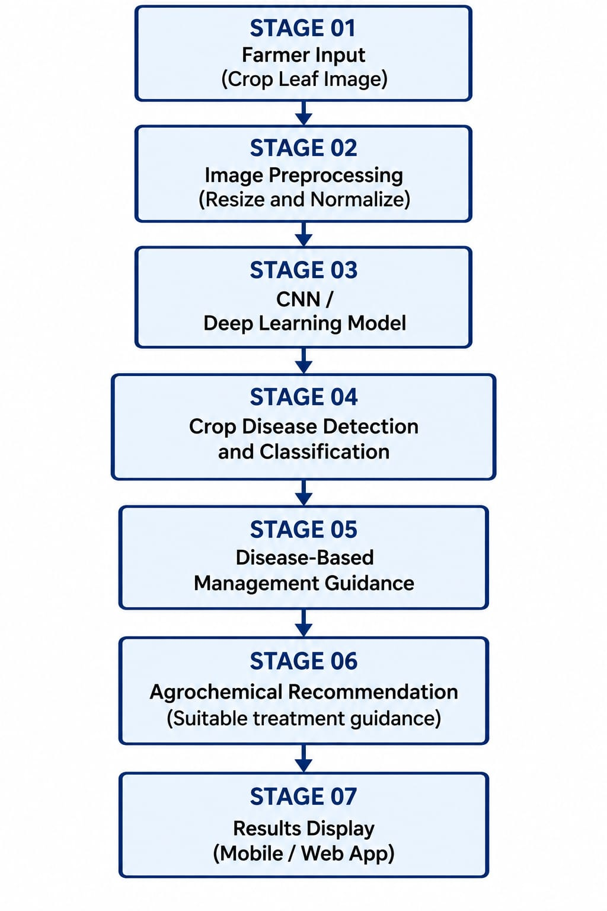
VIII. System Architecture
Figure 1: Architectural Diagram for the Proposed Framework

Slide 13
IX. Proposed Methodology
Methodology Workflow
Step 1 - Image Input: Farmer uploads a crop leaf image through the application.
Step 2 - Image Preprocessing: Image is resized, normalized, and prepared for model input.
Step 3 - Disease Classification: The AI model identifies the crop disease or classifies the leaf as healthy.
Step 4 - Agrochemical Recommendation: The system suggests suitable disease-management treatments based on the predicted disease and verified agricultural information.
Step 5 - Result Display: The application displays the predicted disease, confidence score, and relevant treatment recommendations.
Output: An integrated AI-powered system for crop disease detection and smart agrochemical recommendation.

Slide 14
X.Module Breakdown
Module 1: Dataset & Preprocessing
Collect and label crop leaf images.
Resize, normalize, and augment images.
Module 2: Disease Detection
Classify healthy and diseased leaves using deep learning.
Evaluate model performance using standard metrics.
Module 3: Agrochemical Recommendation
Map detected diseases to suitable treatments.
Use verified agricultural information for recommendations.
Module 4: Integration & Output
Integrate both modules into one application.
Display disease predictions and treatment recommendations.

Slide 15
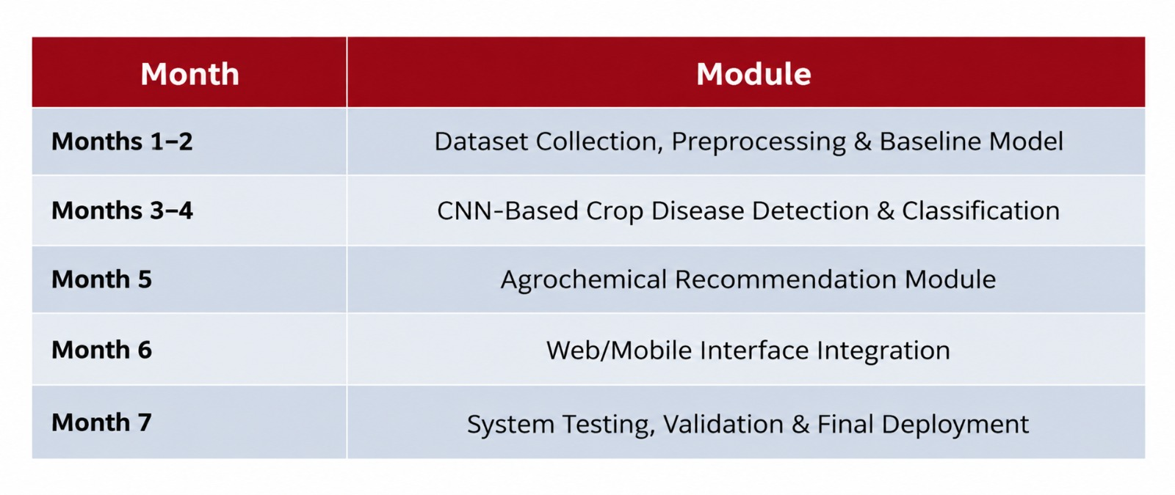
XI. Project work plan and timeline

Slide 16
XII.References
Hassan, S. K. M., & Maji, A. K. (2022). “Plant Disease Identification Using a Novel Convolutional Neural Network,” IEEE Access. Link
Xan, C. J., et al. (2024). “Effective Edge Solution for Early Detection of Rice Disease,” IEEE Access. Link
Maurya, R., Rajput, L., & Mahapatra, S. (2025). “RAI-Net: Tomato Plant Disease Classification,” IEEE Access. Link
Xiao, W., et al. (2025). “Research on Citrus Leaf Disease Recognition,” IEEE Access. Link
Pham, T.-C., et al. (2025). “Enhancing Coffee Leaf Disease Classification,” IEEE Access. Link
Khan, A. A., Faheem, M., Bashir, R. N., Wechtaisong, C., & Abbas, M. Z. (2022). “Internet of Things (IoT) Assisted Context Aware Fertilizer Recommendation,” IEEE Access. Link
Khaliq, A., et al. (2025). “AI-Driven Smart Agriculture: An Integrated Approach for Soil Analysis, Irrigation, and Crop-Fertilizer Recommendations,” IEEE Access. Link
Awasthi, P., et al. (2025). “Crop Yield Estimation and Fertilizer Optimization,” IEEE Access. Link
Ge, W., Zhou, J., Zheng, P., Yuan, L., & Rottok, L. T. (2024). Knowledge graph and case-based reasoning for fertilizer recommendation, Computers and Electronics in Agriculture. Link
Umar, U., Sardjono, T. A., & Kusuma, H. (2024). “Smart Ontology-Based System for Recommending Practices in Melon Cultivation,” IEEE Access. Link

Slide 17
Datasets and online Resources
S. P. Mohanty, D. P. Hughes and M. Salathé, “Using Deep Learning for Image-Based Plant Disease Detection,” Frontiers in Plant Science, 2016. PlantVillage Dataset —54,306 healthy and diseased leaf images across 38 categories.
D. Singh et al., “PlantDoc: A Dataset for Visual Plant Disease Detection,” Proc. ACM India Joint International Conference on Data Science and Management of Data (CoDS-COMAD), 2020, pp. 249–253. PlantDoc Dataset — real-world plant disease images useful for testing performance beyond controlled datasets.
Fertilizer Recommendation Dataset, Kaggle, 2025. Online. Available: Kaggle Fertilizer Recommendation Dataset

Slide 18













Department of Computer Science and Engineering Alliance School of Advanced Computing
THANK YOU
Presented by
ASAC-CP-009
©ASAC – Alliance University, 2026. All rights reserved. Unauthorized reproduction or distribution is prohibited.

